Slide 1
Innovative Projects- Raspberry-pi Using Python (CSE1003) Phase –III Review Presentation Ear Electronic Device For Tinnitus Frequency Finding and Adjusting to Provide Relief To Tinnitus Suffering Patient
Submitted to the Presidency University, Bengaluru in partial fulfillment of the requirements for the Innovative Project- Raspberry-pi using Python
IPR-217
Under the supervision of Under the supervision of
Dr.Mohammad Shahnawaz Hussain
Assistant Professor Department of Electronis & CommunicationEngineering
Name | Roll Number
Shubham Kumar | 20221CSE0721
Kiran T B | 20221CSE0686
Hari Krishna M | 20221CSE0674
Manjunath Royal B S | 20221CSE0690
Gurupadeshwar | 20221CSE0672
Muralikrishna U | 20221ECE0186

Slide 2
Project Brief Summary
These are small electronic gadgets that generate specific sounds to mask or override the ringing of tinnitus. They offer various features to customize the sound output according to the user's preferences.
These specialized electronic devices emit soothing sounds, effectively masking or covering up the perceived tinnitus noises. They offer a variety of sound options, ranging from white noise, nature sounds, or customized tones to match an individual's preference.
The ultimate goal is to achieve habituation, not only in regard to the perception of tinnitus but, more importantly, to the emotional response associated with tinnitus.

Slide 3
Challenges Faced in Project
•Due to limited information about this project it was a challenging thing for our team to find the info about this model.
•As we do not have any idea about the audio signal processing it is a major challenge in this project on which we are trying to figure it out.
•Providing long-term relief from tinnitus symptoms is a major challenge. While some devices have shown promising results, more research is needed to confirm their effectiveness which is a lengthy process.
Providing long-term relief from tinnitus symptoms is a major challenge

Slide 4
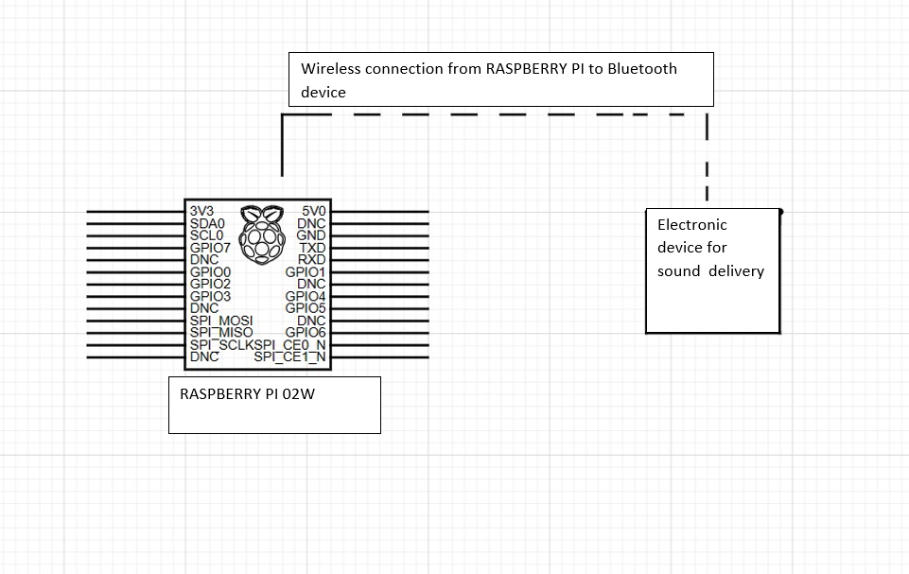
Circuit/Block Diagram

Slide 5
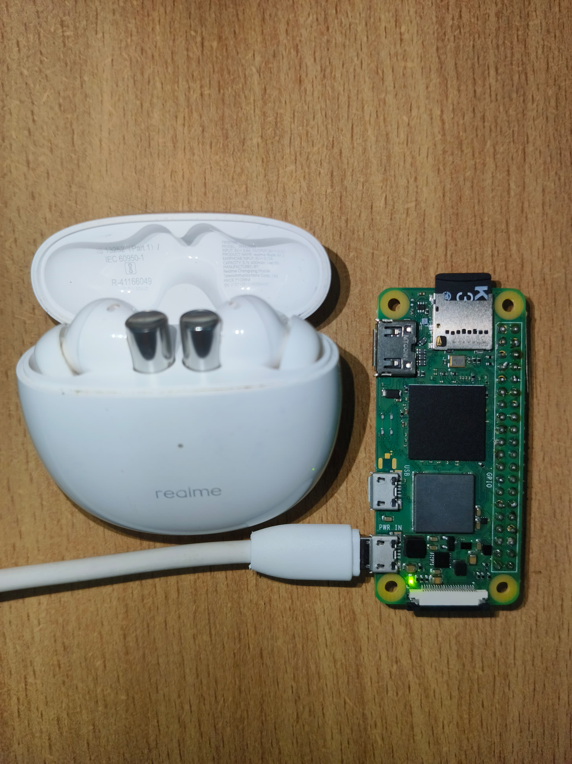
Results and Discussions
•We have established a configuration of the Rasberry pi along with its coding environment.
•We are working on connecting the rasberry pi to ear electronic device to take audio input and signal processing part to generate output.
•This is just a model , We are still researching about this project as it is a new concept for us our team are trying to solve it.

Slide 6
Q&A

Slide 7
Thank you !!

